Slide 1
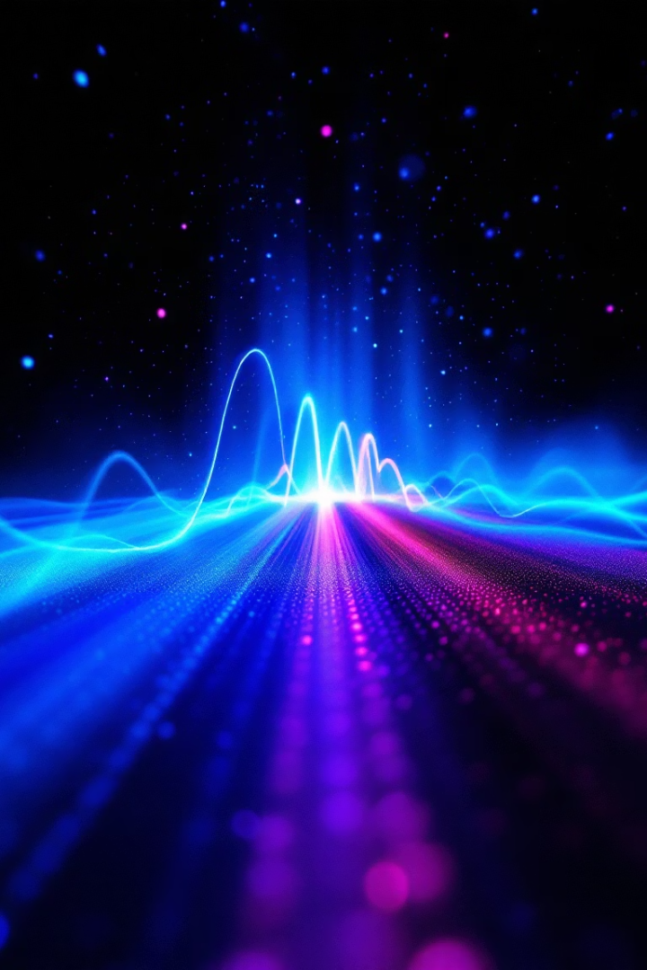
Understanding the Light Spectrum: Focus on Blue Light
The electromagnetic spectrum spans from radio waves to gamma rays, with visible light occupying the 380-700 nm range.
Blue light (380-500 nm) has significant biological impacts. Our exposure is increasing through digital devices and LED lighting.
os
by osadeyi sola

Slide 2
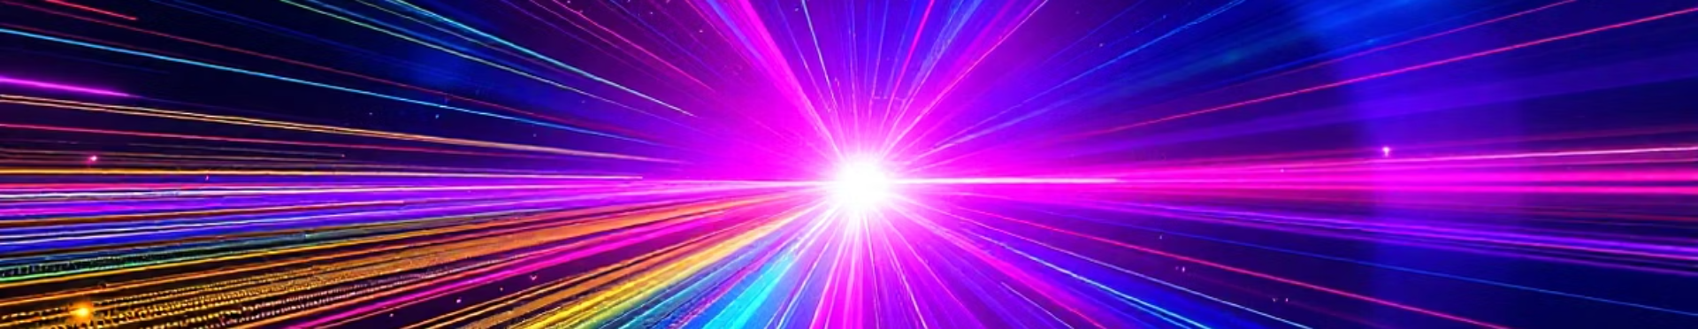



The Electromagnetic Spectrum Overview
Radio Waves
Visible Light
Gamma Rays
Longest wavelength
380-700 nm range
Shortest wavelength
Radiation is organized by wavelength and frequency. Energy increases as wavelength decreases.

Slide 3










Visible Light Spectrum Breakdown
Blue
Violet
450-495 nm
380-450 nm
Green
495-570 nm
Red
620-700 nm
Yellow
570-590 nm

Slide 4
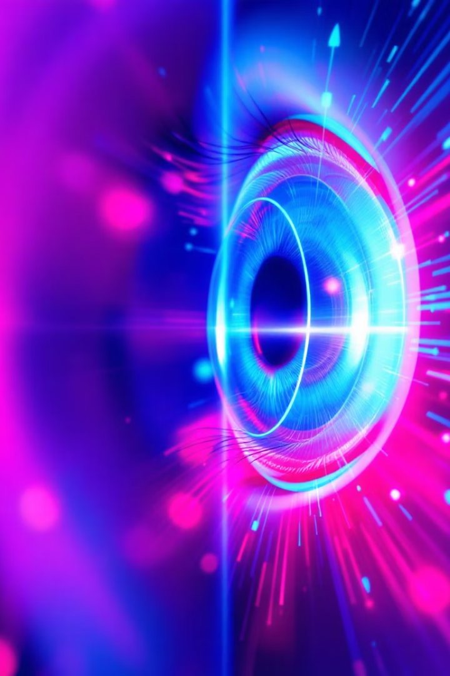
Blue Light (380-500 nm): Key Characteristics
Highest Energy
Contains the highest energy wavelengths in the visible spectrum.
Eye Penetration
Penetrates deeper into the eye than other visible light.
Sources
Natural: sunlight. Artificial: LEDs, screens, fluorescent lighting.
Biological Role
Critical for regulating circadian rhythm and alertness levels.

Slide 5
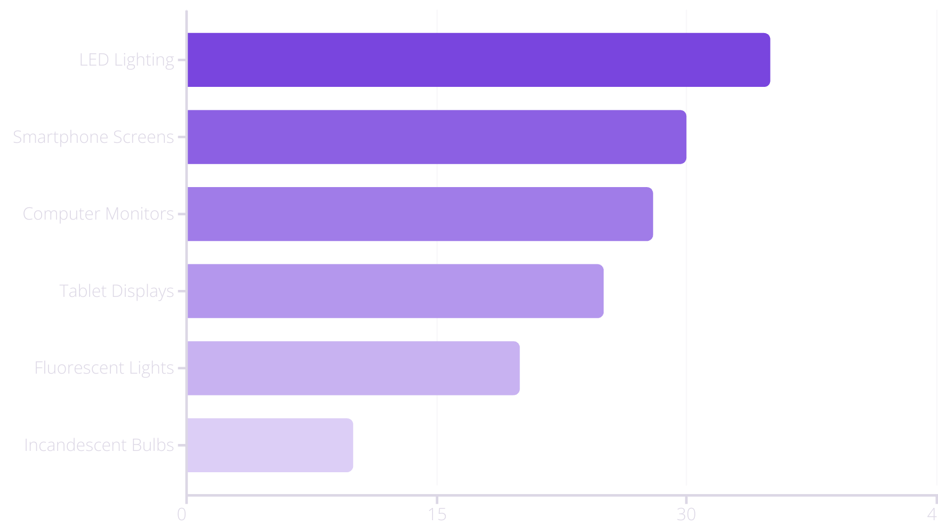
Blue Light Sources in Modern Life

Slide 6








Health Impacts of Blue Light Exposure
Daytime Benefits
Improves alertness, mood, and reaction times
Digital Eye Strain
Affects 65% of Americans
Sleep Disruption
Reduces melatonin by up to 50%
Long-term Concerns
Possible retinal damage and macular degeneration

Slide 7





Blue Light Protection Strategies
Filtering Eyewear
Blue light glasses block 20-60% of harmful wavelengths.
Device Settings
Use night mode and screen filters after sunset.
20-20-20 Rule
Every 20 minutes, look at something 20 feet away for 20 seconds.
Home Lighting
Install warm-toned bulbs in evening environments.

Slide 8




Key Takeaways: Managing Blue Light Exposure
Beneficial by day
Enhances alertness and mood
Harmful at night
Disrupts sleep and circadian rhythms
Strategic management
Balance benefits and risks
Digital wellbeing
Awareness is crucial

